Slide 1
Theory of Automata
Lecture no 4

Slide 2
Kleene Closure
Set closure
Kleene Closure (applied to ∑)
  A set of all the strings (finite) that can be formed by the elements of ∑ where the elements may be repeated any number of times.
  Denoted by ∑*
  Also called Kleene star.

Slide 3
∑* : The set of all strings over an alphabet ∑ and called Kleene Star Closure of alphabet. So we have
  ∑* = ∑⁰ U ∑¹ U ∑² U ∑³ U……………
∑⁺ : The set of all strings over an alphabet ∑ excluding empty string, ε, and called plus operation. So we have
  ∑⁺ = ∑¹ U ∑² U ∑³ U……………

Slide 4
Some observations
Λ represents an empty string (not alphabet thus not a part of ∑)
ε also represents the same
ε is not equivalent to ϕ
If ∑ = ϕ then
  ∑* = {Λ}
Is S* == (S*)* and so on

Slide 5

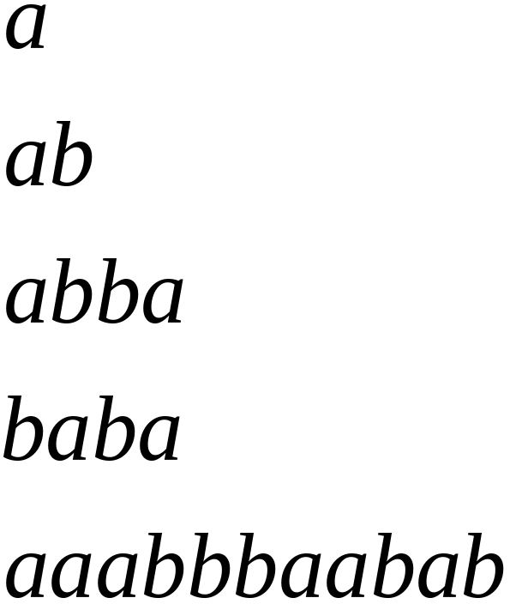
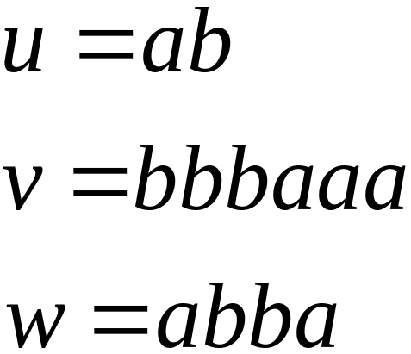
Alphabets and Strings
We will use small alphabets:
Strings

Slide 6
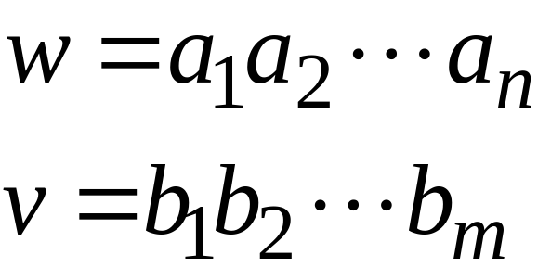
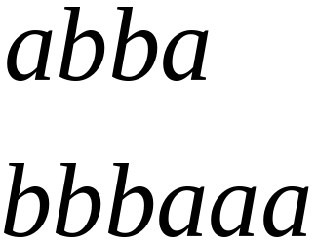
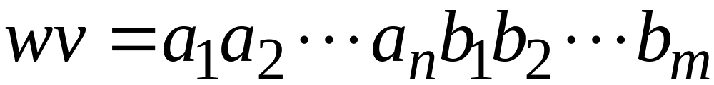

String Operations
Concatenation

Slide 7




Reverse

Slide 8


String Length
Length:
Examples:

Slide 9
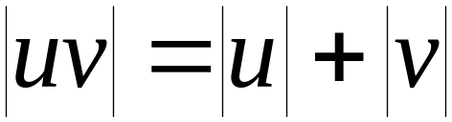

Length of Concatenation
Example:

Slide 10
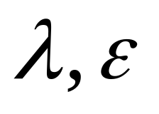
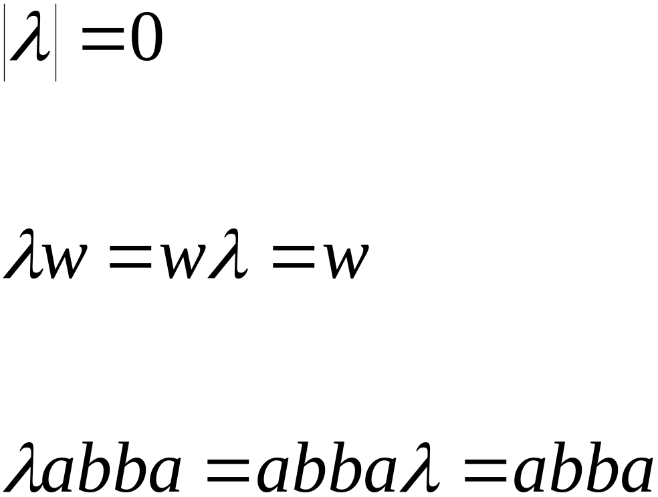
Empty String
A string with no letters:
Observations:

Slide 11


Substring
Substring of string:
  a subsequence of consecutive characters
String Substring

Slide 12




Prefix and Suffix
Prefixes Suffixes
prefix
suffix

Slide 13




Another Operation
Example:
Definition:

Slide 14



The * Operation
: the set of all possible strings from
alphabet

Slide 15


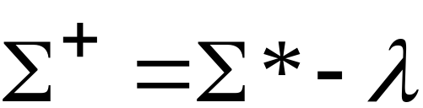
The + Operation
: the set of all possible strings from
alphabet except

Slide 16


Languages
A language is any subset of
Example:
Languages:

Slide 17
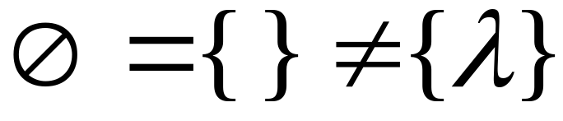



Note that:
Sets
Set size
Set size
String length

Slide 18




Another Example
An infinite language

Slide 19


Operations on Languages
The usual set operations
Complement:

Slide 20



Reverse
Definition:
Examples:

Slide 21


Concatenation
Definition:
Example:

Slide 22



Another Operation
Definition:
Special case:

Slide 23



More Examples

Slide 24


Star-Closure (Kleene *)
Definition:
Example:

Slide 25
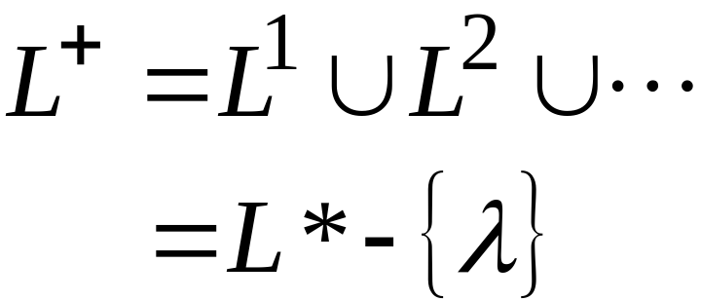

Positive Closure
Definition:

